Slide 1
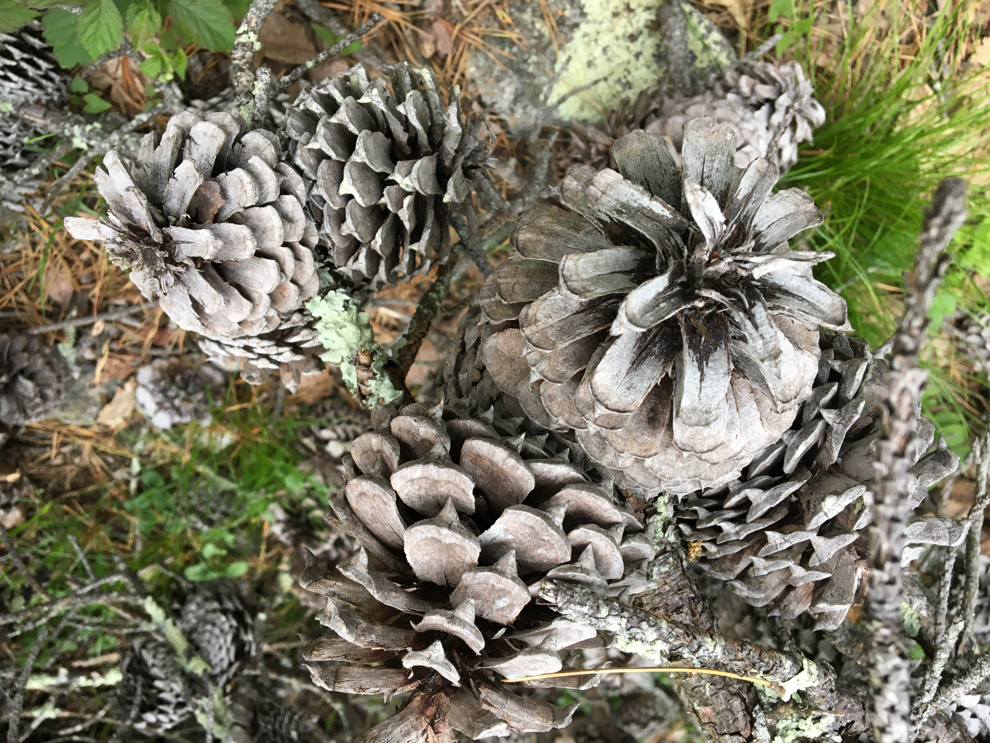
Photo by James Gardner
Sunday, December 6, 2020
Culmore
United Methodist Church
Words and Music

Slide 2
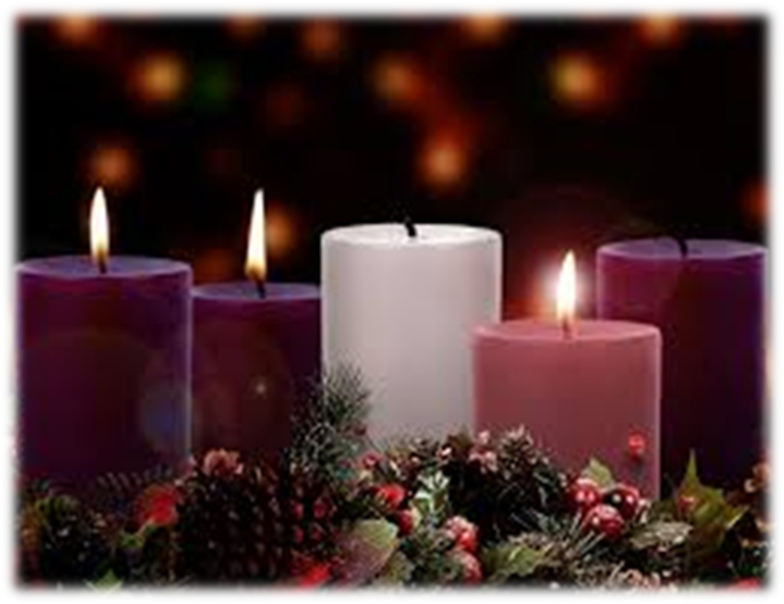
A Candle is Burning
A candle is burning,
a candle of JOY,
A candle to welcome
brave Mary's new boy
Our hearts fill with wonder
and eyes light and glow
As joy brightens winter
like sunshine on snow

Slide 3
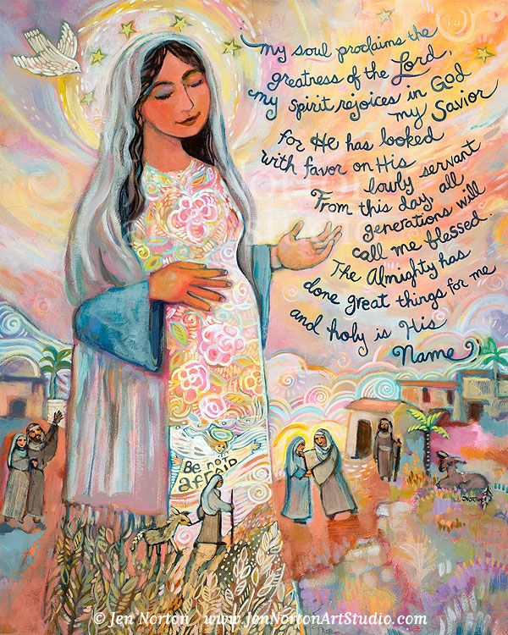
Magnify the Lord - Luke 1:46-49
Rejoice in God, rejoice in God
who has done great things for me.
Rejoice in God, rejoice in God
who has done great things for me.
Magnify the Lord, magnify the Lord,
who is my savior and my God!
Magnify the Lord, magnify the Lord,
magnify the Lord, who is my savior

